Slide 1




25 Most Popular TV Shows
Giulia Neves Monteiro

Slide 2
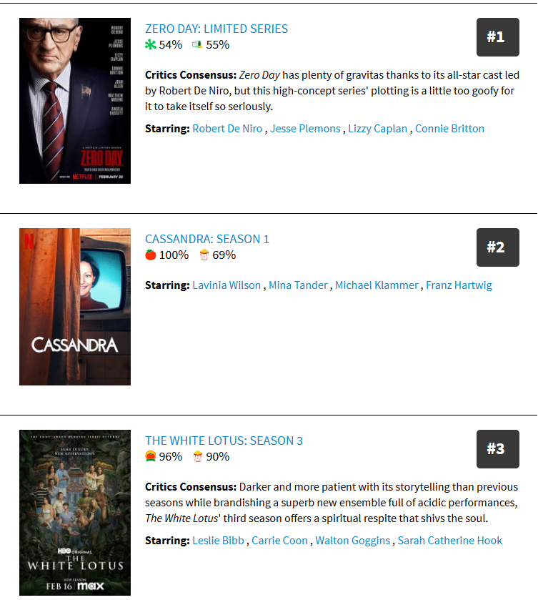

Notes:
Scrapped the rotten tomatoes top 25 tv show website
I started by pulling the tv show name, tomato and popcorn ratings, which are based on the critics and audience, respectively, and the overall rating.

Slide 3
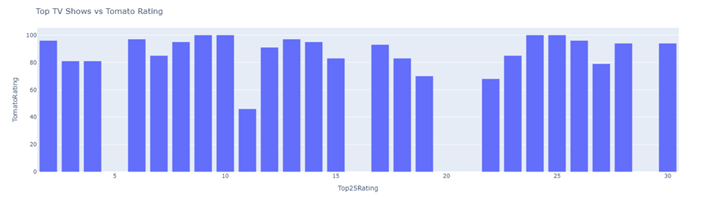

TV Show | Tomato Rating | Popcorn Rating
The White Lotus | 96 | 91
Apple Cider Vinegar | 81 | 72
Paradise | 81 | 82
Severance | 97 | 75
Notes:
I did several comparisons between the ratings and found it interesting how there wasn't a correlation between the #1 most popular tv show and rating.
possibly indicating that a show may be ranked at #1 simply bc it's new despite not having the highest score

Slide 4
Sentiment Analysis
Notes:
I then gathered all the comments from the tv shows and performed a sentiment analysis

Slide 5
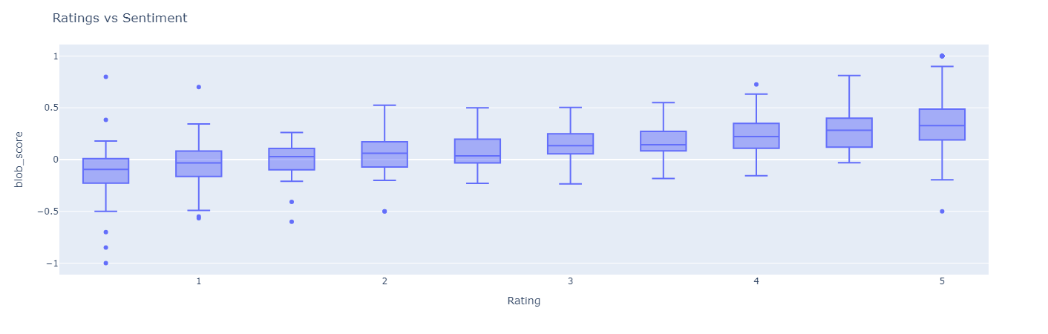
Increased ratings for higher sentiment scores

Slide 6
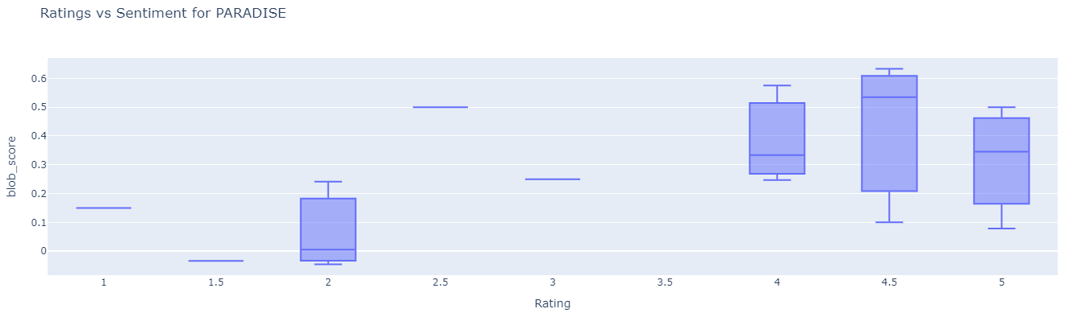
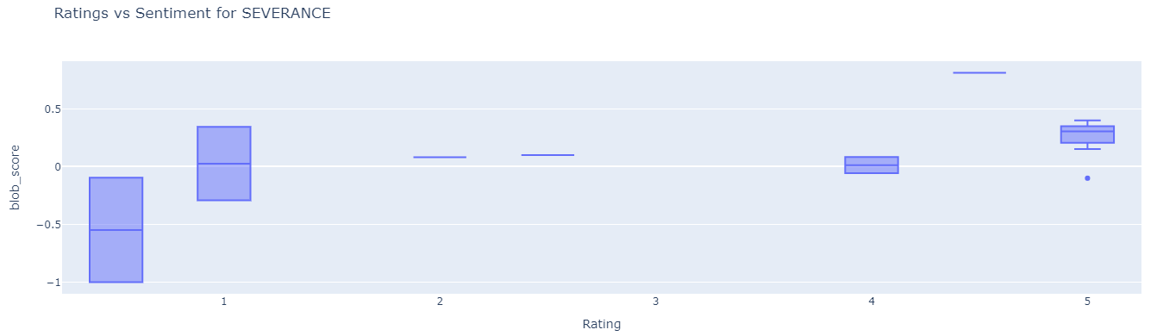
Paradise vs Severance

Slide 7
Topic Modeling

Slide 8
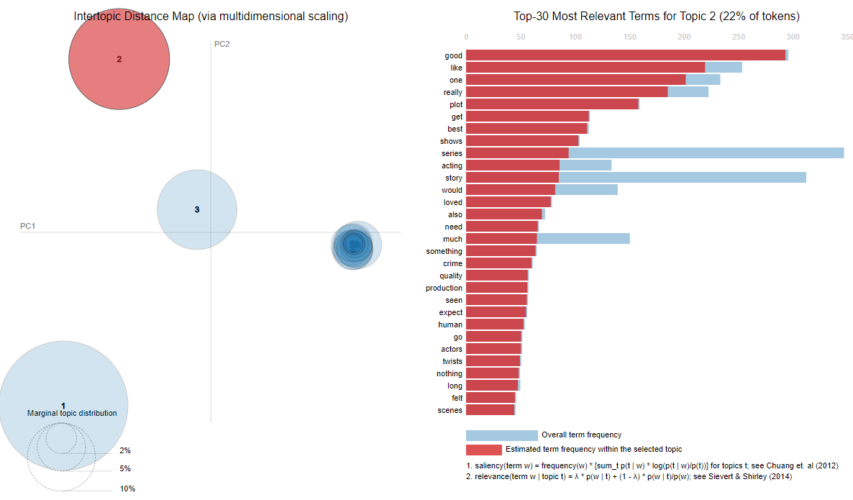
Notes:
Another example from topic 2 it seems to be about positive reviews, as it has words like: good, like, best, and loved

Slide 9


Thank you!

